Slide 1
OAS Sustainable Cities Course
St. Kitts & Nevis. May 31st – June 3rd, 2017
Presented by:
Cametha John – St. Vincent and the Grenadines

Slide 2
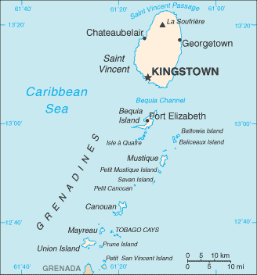
About St. Vincent and the Grenadines (SVG)
Population - Approx. 102,350
Multi-island, English speaking state (32 islands and cays)
Total Area - 150 square miles / 389 km²
Capital - Kingstown
Urban Population Share - 50.6%
Tropical Climate
Mountainous topography
Major Features - La Soufriere Volcano and Botanical Gardens
Currency - Eastern Caribbean Dollars (USD1= XCD2.67)

Slide 4
Start Bright Tus-T School breakfast Programme
An initiative by All Island Recyling Inc. in primary schools.
Two (2) supporting pillars: Tus-T water sales and recycling of different brands of plastic beverage bottles.
For the school year 2016-2017 children served daily went from 60 to 375 and 12 to 75 schools (primary and secondary combined) in all 11 school districts.
In January 2017, 10 children were served breakfast in 4 schools. Presently 395 breakfasts are being served daily.

Slide 5
Schools Feeding Programme
Initiative by the Ministry of Education in collaboration with the Ministry of Health, Wellness and the Environment.
Makes balanced, nutritious meals available to all children attending Primary Schools and Early Childhood Educational Centres.
Aim: to provide one-third (⅓) of the daily nutrient requirement to the beneficiaries in hopes of alleviating problems that may inadvertently affect learning.
Head teacher and supervising teacher at each school are responsible for the daily operation of the programme.
Approximately 110 kitchen attendants employed who are responsible for food preparation and service.
Sixty-four (64) primary schools and nine (9) pre-schools on the programme. In 2015-2016 the schools’ population was 13,173 with total of 7,765 students benefitting from the School Feeding Programme in that year.

Slide 7
Fresh Water Resources
The mainland St. Vincent has 100% coverage provided by the Central Water and Sewerage Authority (CWSA), which does treatment, transmission and distribution of potable water to domestic, commercial, shipping, and government customers.
About 98 % of the households have pipe-borne water directly to them.
The Grenadines has no surface water and relies on rainwater harvesting and a few artesian wells.
A Reverse Osmosis plant was installed in Bequia. It is driven by solar energy and hoped to be reproduced in other Grenadine islands.

Slide 8
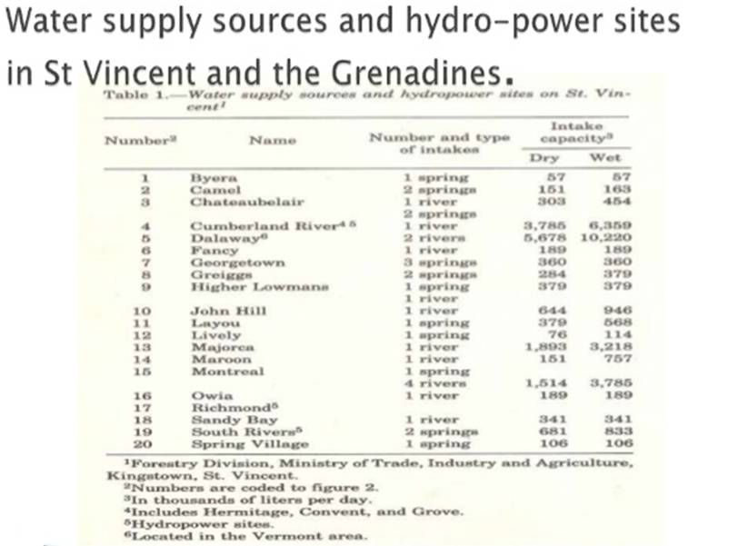

Slide 10
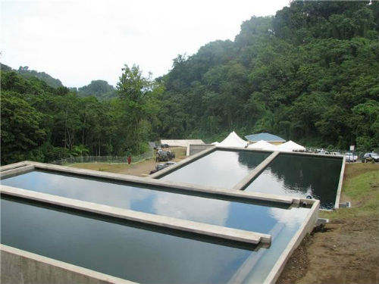
A water catchment in North Eastern section of St. Vincent

Slide 11
Waste Management
Every community on the mainland has collection of solid waste at least once per week for disposal at landfill.
Private refuse collection companies serve many corporate entities.
Chlorofluorocarbons (CFCs) have been completely phased out.
An active private sector lead scrap metal recycling export programme in place.
More plastic wastes being recycled locally by All Island Recycling Inc.
SVGCC launched a waste management project in April 2017
-Phase 1: Comprehensive Recycling programme
-Phase 2: Composting and backyard gardens on campus

Slide 13
National Energy Policy (NEP)
This policy was established in 2009 to provide a plan for the energy sector that addresses sustainability issues.
The National Energy Action Plan (NEAP) was established in 2010, which consolidated policies into actionable steps.
The country identified a goal of generating 30% of all electric output from renewable energy sources by 2015 and 60% by 2020.
VINLEC generates, transmits, and distributes electricity in SVG except in Palm Island and Mustique who are supplied by privately owned electricity systems.
VINLEC has a generation capacity of 58.3 MegaWatts (MW), of which 5.6 MW comes from 3 hydropower plants, with the remainder made provided by diesel generators.
Residential rates start at $0.26 per kilowatt-hour (kWh), below the Caribbean regional average of $0.33/kWh

Slide 14
Geothermal Development Project
To deliver a 10 MW geothermal power plant to SVG
Partners: Reykjavik Geothermal, Light and Power Holdings Ltd, Government of St. Vincent and the Grenadines, Clinton Climate Initiative, VINLEC
Project Activities Completed:
Environmental and Social Impact Assessment, Parrot Census, Resettlement Action Plan, Vesting of lands, Phase 1 Civil Contract: Site Access and Road Improvement, Grants and Agreements signed
Project Activities for 2017:
Phase 2 Civil Works, Power Purchase Agreement, Drilling Contract , Cost Assessment for VINLEC Transmission Lines.

Slide 15
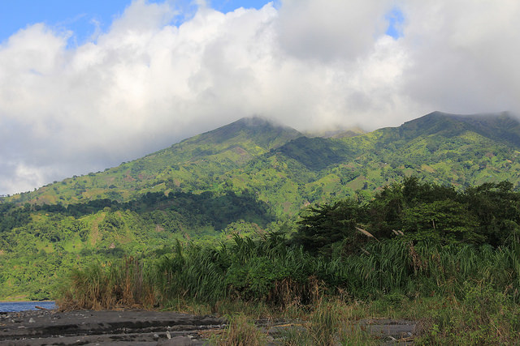
The slopes of La Soufriere volcano being explored for geothermal potential.

Slide 16
Solar Photo Voltaic Demonstration and Scale-Up Project
To install a 200 kW roof mounted solar photovoltaic (PV) system on several Government buildings and to provide technical assistance to develop appropriate financial mechanisms.
Partners: Energy Unit, World Bank, Ministry of Health, Wellness and the Environment, VINLEC
Project Activities for 2017:
200 kw Solar PV to be installed at the Division of Technical and Vocational Education (Community College)
Strengthen the government’s capacity and sector knowledge through an on-the-job capacity-building experience
Compensation for building owner through a rooftop lease arrangement with periodic payment and/or reduced electricity costs.

Slide 17
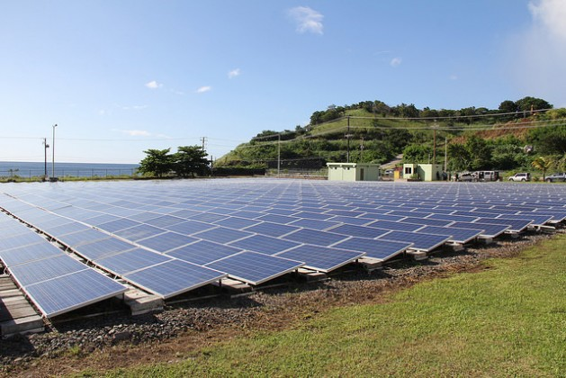
750 kilowatt hours of photovoltaic panels were installed, to reduce carbon emissions by 800 tonnes annually

Slide 18
Energy for Sustainable Development in Caribbean Building (ESD)
To establish and implement measures for promoting sustainability within the buildings sector in St. Vincent and the Grenadines (SVG).
Partners: Energy Unit, Ministry of Housing, Ministry of Transport and Works
Project Activities 2017:
Retrofit of lights in Public Library.
Rewiring of Electrical System in Public Library.
Installation of a 75kW Solar photovoltaic system at the Argyle International Airport.
Implementation of Energy Efficiency Building Codes.
Establish Energy Labeling Standards

Slide 20
Ban on Styrofoam
Item is non-biodegradable, difficult to recycle and very common.
Health related issues linked to use of the product.
First phase of ban on Styrofoam products in food service industry was effective May 1st, 2017.
Total outlaw effective February 1st, 2018. No importation, selling, serving or packaging of food in it.

Slide 22
Fisheries Code of Conduct and Legislation
The Fisheries Division uses the FAO code of conduct on responsible fishing in its work with fisher folk and civil society groups, to enable compliance with fisheries regulations aimed at making fishing sustainable while adhering to the international agreed fishing practices.
As of January 1st, 2017, the catching or killing of sea turtles, or disturbing of their nests became illegal.
Laws are to be passed to outlaw the killing of Orcas (Killer whales) in keeping with an international ban signed onto re the killing of Bottlenose Dolphins and Killer whales.

Slide 23
Thank you! ☺

